Slide 1
Game Dynamics Programming Part 2

Slide 2
Momentum and Impulse
+ some worked examples

Slide 3
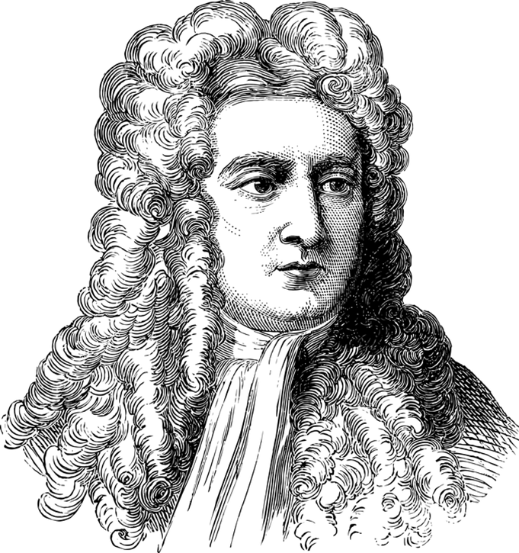
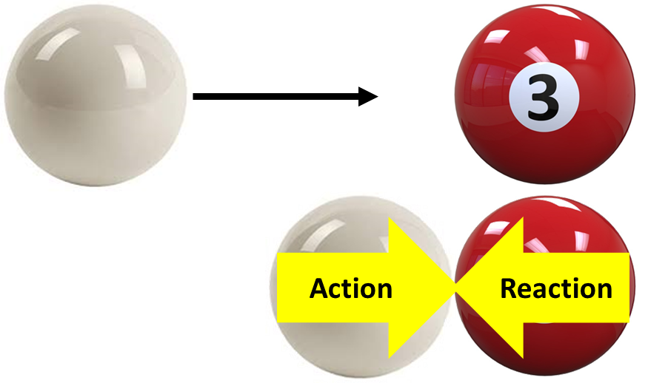
Newton’s Third Law of Motion
“For every action, there is an equal and opposite reaction.”
A good example is when two snooker balls collide. Here, the white ball applies a force to the red ball, which applies an equal and opposite force to the white ball.
This is important when dealing with collisions.
How objects react during collisions is closely related to the concept of Momentum, which we’ll look at later in these slides.

Slide 4
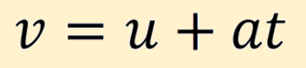
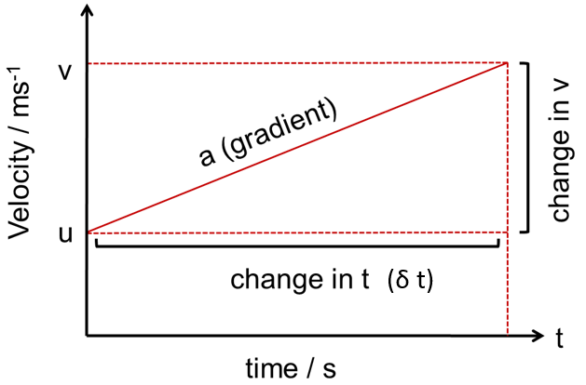
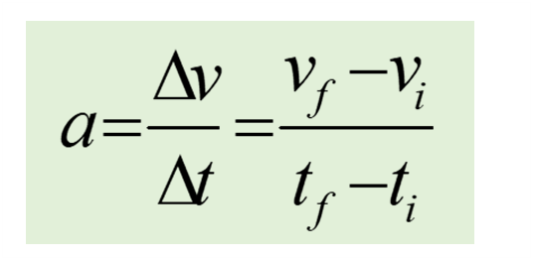

Slide 5
A driver of a vehicle travelling at a speed of 30 m/s on a motorway brakes to a standstill in a distance of 100m. Calculate the deceleration of the vehicle
Example 1
Solution
Initial Speed u=30 m/s
Final Speed v=0 m/s
Distance s=100m
Deceleration a=? m/s²
Time t=? s
v² = u² + 2as
a = v² – u² = (0)² – (30) ²
2s 2(100)
= -4.5 m/s² acceleration (or 4.5 m/s² deceleration)

Slide 6
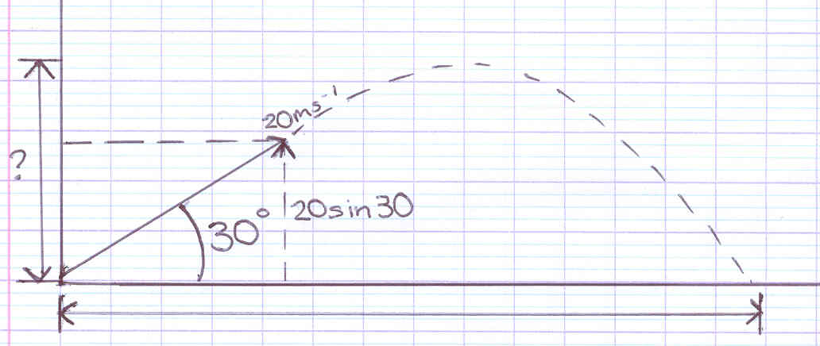
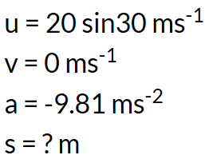
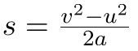
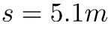
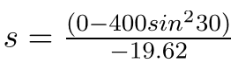
A ball is thrown at an an angle of 30°. It has an initial velocity of 20ms⁻¹. Find the maximum height the ball would reach.
Example 2
v² = u² + 2as
http://physicsforidiots.com/physics/dynamics/

Slide 7
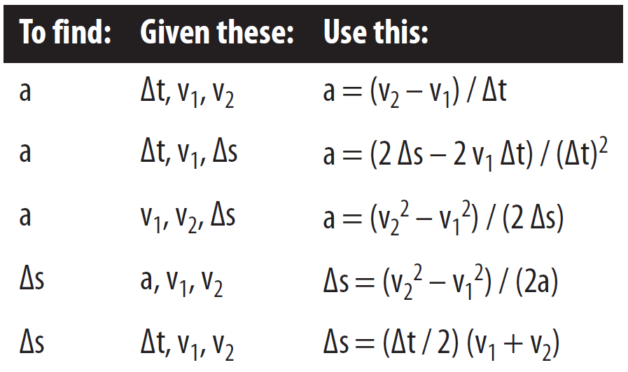
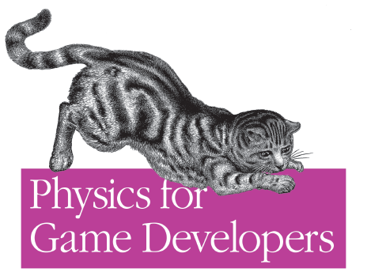

For your reference

Slide 8
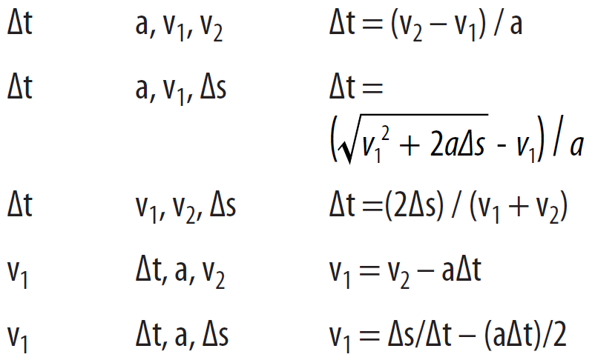
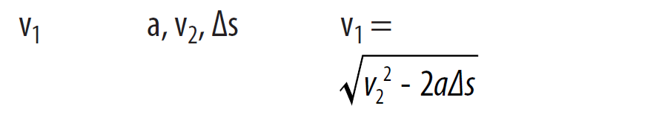

Slide 9
The kinematic equations are used to determine an object’s position over time
Inputs
Outputs
Mass
m
dt = t_{i+1} - t_{i}
Force
f
v_{i+1} = v_{i} + (f/m) * dt
Velocity
v_{i}
p_{i+1} = p_{i} + v_{i+1} * dt
Position
p_{i}
Time
t
All in the same time step
Values from the previous frame

Slide 10
Called the
Semi-implicit Euler method
dt = t_{i+1} - t_{i}
We won’t go into the details, but it’s called semi-implicit because it uses v_{i+1} to calculate the position at i+1
Usually, p_{i+1} = p_{i} + v_{i} * dt
v_{i+1} = v_{i} + (f/m) * dt
p_{i+1} = p_{i} + v_{i+1} * dt
http://www.cs.uu.nl/docs/vakken/mgp/2018-2019/
(See Lecture 5)
0
If f is 0, then v_{i+1} is also 0
v_{i+1} = v_{i} + (0/m) * dt
f = 0

Slide 11
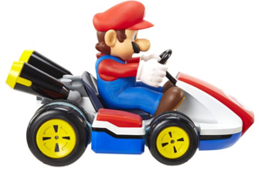
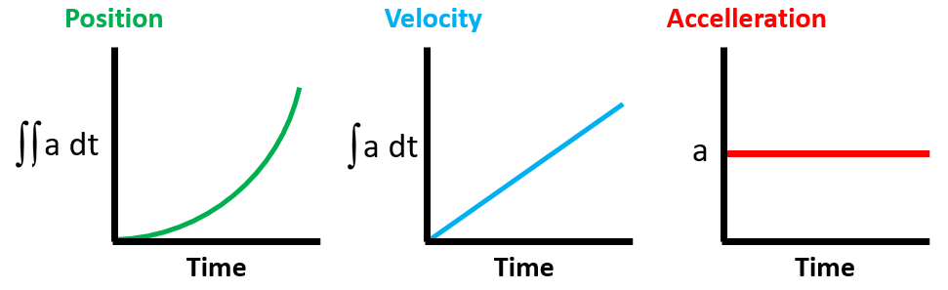
So this is why it’s called the
physics integration step
Displacement
integration
integration
But don’t worry, we won’t be doing any calculus here!

Slide 12
Newton’s Third Law of Motion
“For every action, there is an equal and opposite reaction.”
A good example is when two snooker balls collide. Here, the white ball applies a force to the red ball, which applies an equal and opposite force to the white ball.
Okay, back to Newton’s Third Law
This is important when dealing with collisions.
How objects react during collisions is closely related to the concept of Momentum, which we’ll look at now.

Slide 13
Newton’s First Law of Motion
“Every object persists in its state of rest or uniform motion in a straight line unless it is compelled to change that state by forces impressed upon it.”
Remember
But how difficult is it to change the motion of an object?
A heavy truck is harder to stop than a small car moving at the same speed. We say that the truck has more momentum than the car.
A small bullet moving at a high speed can have the same large momentum as a huge ship moving at a small speed.

Slide 14
By Momentum we mean inertia in motion
Momentum = mass × velocity or
Momentum = mv
When direction is not an important factor:
Momentum = mass × speed
p = mv

Slide 15


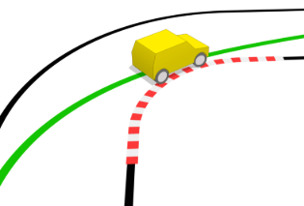
Change in momentum is:
change in mass
change in velocity
or both

Slide 16
First law - The law of inertia
Every object continues in its state of rest, or of uniform motion in a straight line, unless it is compelled to change that state by forces impressed upon it.
Continues: an object continues to do whatever it happens to be doing unless an (unbalanced) force exerted upon it.
Inertia:
The property of objects to resist changes in motion.

Slide 17
Impulse
Both the force and the time applied are important for changing momentum.
Impulse: the product of force and this time interval.
Impulse = force × time interval or
Impulse = Ft
Impulse = change in momentum.
Unit is N.s or kg.m/s

Slide 18
Examples
Increasing momentum: apply the greatest force and extend the time of application
Long-range cannon have long barrels-long acting time
Decreasing momentum over a long time
Difference between a running car hitting the haystack and hitting the wall
A large change in momentum in a long time requires a small force. A large change in momentum in a short time requires a large force.

Slide 19
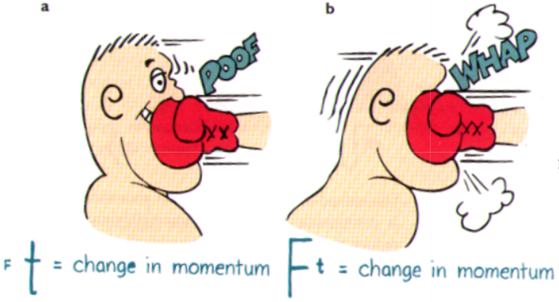
Decreasing momentum over a short time
Boxing
A Karate expert breaking a stack of bricks
The boxer is moving away when the glove hits, thereby extending the time of contact. This means the force is less than if the boxer had not moved.
The boxer is moving into the glove, thereby lessening the time of contact. This means that the force is greater than if the boxer had not moved.

Slide 20
Conservation of Momentum
If no external force is present, then no change in momentum is possible, in which case, we say the momentum of the system is conserved.
Internal forces: forces that act and react within the systems themselves.
Momentum is a vector quantity.
The momentum of the system of the rifle and the bullet before firing is zero.
After firing, the net momentum of the system is still zero. We say that the momentum of the rifle-bullet system is conserved.

Slide 21
Consider a fish that swims toward and swallows a smaller fish at rest. If the larger fish has a mass of 5 kg and swims 1 m/s toward a 1-kg fish, what is the velocity of the larger fish immediately after lunch? (Neglect the effects of water resistance.)
Answer:
Net momentum before lunch = net momentum after lunch
(5 kg ) (1 m/s) + (1 kg) (0 m/s) = (5 kg + 1 kg) v
5 kg m/s = (6 kg) v
v = 5/6 m/s. How about if the small fish is not at rest but swims toward the big fish at a velocity of 4 m/s?

Slide 22
When applied to collisions, the sum of the momentum before and after the collision is equal.
p₁ + p₂ = p’₁ + p’₂
momentum of particle 1 before collision
momentum of particle 2 before collision
momentum of particle 1 after collision
momentum of particle 2 after collision
That is,
m₁v₁ + m₂v₂ = m₁v’₁ + m₂v’₂

Slide 23
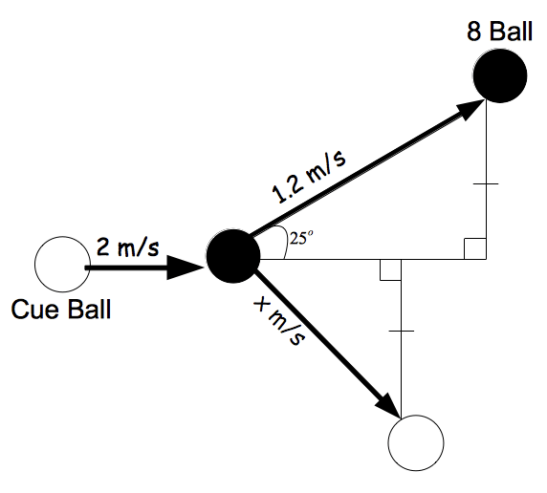
Momentum along the X axis is conserved.
Note
Momentum along the Y axis is conserved.
Before the collision below, the Cue Ball has 0 momentum along the Y axis, so after the collision the two balls must have equal speed but in opposite directions, as shown (ie. both velocities cancel out to 0).
https://www.ck12.org/physics/Elastic-Collisions/lesson/Elastic-Collisions-PPC/

Slide 24
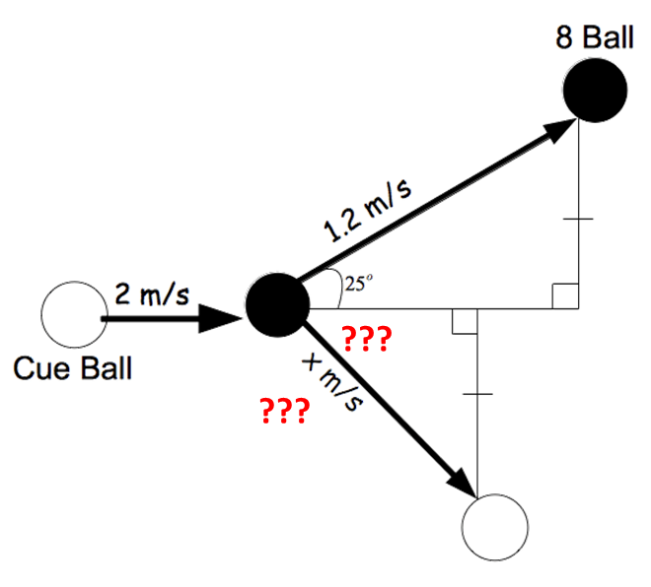
Chris and Ashley are playing pool. Ashley hits the cue ball into the 8 ball.
The cue ball and the 8 ball react as shown below.
The 8 ball and the cue ball both have a mass of .17kg.
What is the speed of the cue ball?
What is the direction (angle) of the cue ball?

Slide 25
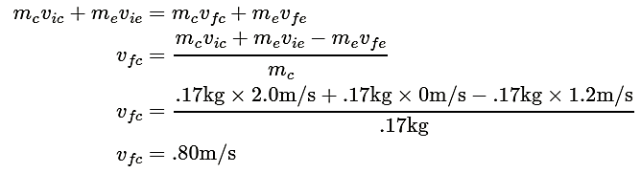
0.80m/s
i - initial
f - final

Slide 26
0.80m/s
We know that the momentum in the y direction of the two balls is equal.
Therefore we can say that the velocity in the y direction is also equal because the masses of the two balls are equal.

Slide 27
0.80m/s
Given this and the diagram, we can find the direction of the cue ball. After 1 second, the 8 ball will have traveled 1.2m. Therefore we can find the distance it has traveled in the y direction

Slide 28
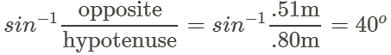
40º
0.80m/s
Therefore, in one second the cue ball will have traveled .51m in the y direction as well. We also know how far in total the cue ball travels in one second (.80m). Thus we can find the direction of the cue ball.

Slide 29
Okay, that’s it for now!
The key topics covered have been:
The theory of Newtonian Dynamics
Newton’s three laws of motion
The SUVAT equations
Projectile Motion
Impulse and Momentum

Slide 30
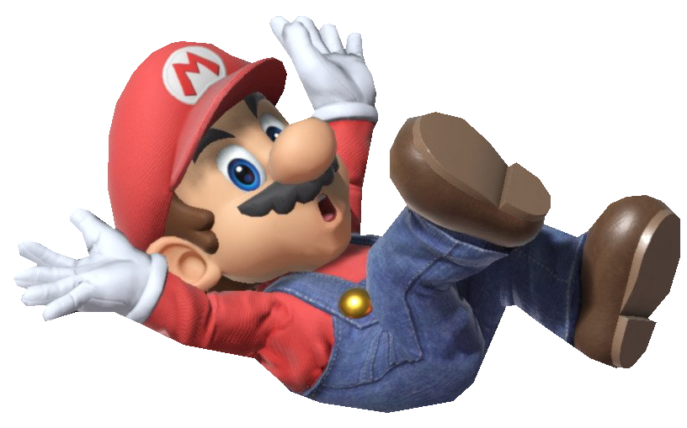
Now do Part 2 of GMAPS__Dynamics_Kinematics.docx

